Slide 2
Conceptual Overview of LLMs
LLMs are trained on massive datasets of code and natural language
They use transformer architecture to understand patterns
Token-based processing: code is broken into tokens
Attention mechanisms help models focus on relevant parts of context
Generate probabilistic next-token predictions based on training patterns
No true “understanding” - pattern matching at massive scale
Notes:
Emphasize that LLMs don’t actually “understand” code like humans do
They use transformer architecture to recognize patterns and context
Token-based processing: code is broken into tokens (words, symbols, operators)
Explain that attention mechanisms are what make modern LLMs so powerful
The scale is what makes the difference - billions of parameters
When we say LLMs “understand” relationships, we mean they can statistically correlate patterns across tokens
This pattern matching is extremely sophisticated but lacks true semantic comprehension
Example: An LLM can recognize that a variable declared early in a function should be referenced later, not because it understands variables conceptually, but because it has seen this pattern millions of times in training
The “understanding” is really about statistical associations between code patterns, not conceptual knowledge
This is why LLMs can generate syntactically correct code that is logically flawed - they match patterns without true comprehension of the underlying logic

Slide 3
General Introduction to LLMs
Large Language Models
Conceptual overview of how LLMs work
Capabilities and limitations of LLMs in coding
Software engineering with AI as a tool vs. “Vibe Coding”
Notes:
Introduce LLMs at a high level: what they are, how they’re trained, and why they matter for developers.

Slide 4
Capabilities
Code completion and generation from natural language
Refactoring and code optimization suggestions
Bug detection and fixing recommendations
Documentation generation
Test case creation
Code explanation and commenting
Multi-language support and translation between languages
Notes:
Capabilities: Describe common uses (completion, refactoring, tests) and show a quick live example if time permits.

Slide 5
Limitations*
No real-time knowledge updates (training cutoff dates)
Can generate syntactically correct but logically flawed code
Hallucination: confident-sounding but incorrect suggestions
Context window limitations (finite memory)
Does not “understand” business logic or domain-specific requirements
Security vulnerabilities if not carefully reviewed
Bias from training data
*Subject to change without notice
Notes:
Limitations: Emphasize hallucination, context limits, and the need for human review and testing.

Slide 6
Do’s
Always review and test AI-generated code
Provide clear, specific prompts with context
Use AI to explore different implementation approaches
Leverage AI for documentation and test generation
Notes:
Do’s: Give practical tips—clear prompts, review, testing, and using AI for repetitive work.

Slide 7
Don’ts
Blindly accept AI suggestions without review
Skip testing because “AI wrote it”
Use AI for critical security or safety-critical code without extensive validation
Rely on AI for architectural decisions without human oversight
Generate code without understanding the underlying logic
Notes:
Don’ts: Warn against blind acceptance of suggestions, entering sensitive data in prompts, and skipping tests.

Slide 8
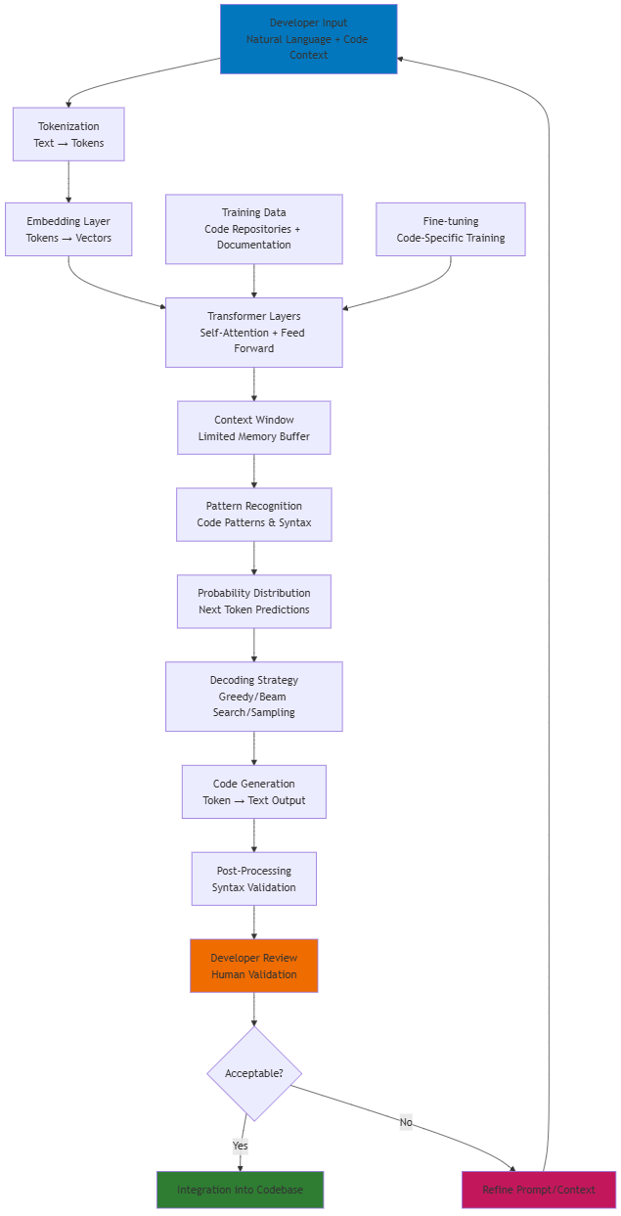
LLM Architecture for Code Generation
Notes:
Input Processing: - Developer provides natural language prompts + existing code context - Input is tokenized into discrete units the model can process - Tokens are converted to numerical vectors (embeddings)
Core Processing: - Transformer layers use self-attention to understand relationships - Context window maintains recent conversation/code history - Pattern recognition identifies relevant code structures and syntax
Output Generation: - Model generates probability distributions for next tokens - Decoding strategies determine how to select from probabilities - Output is converted back to readable code
Human in the Loop: - Critical validation step - AI is a tool, not a replacement - Feedback loop for prompt refinement and learning
Training Influence: - Large code repositories provide pattern knowledge - Fine-tuning specializes models for coding tasks - Quality of training data directly impacts output quality

Slide 9
Comparing LLMs for Code Generation
Public Leaderboards
Core Benchmarks
Surveys & Deep‑Dive Research
Evaluation Frameworks

